Slide 1
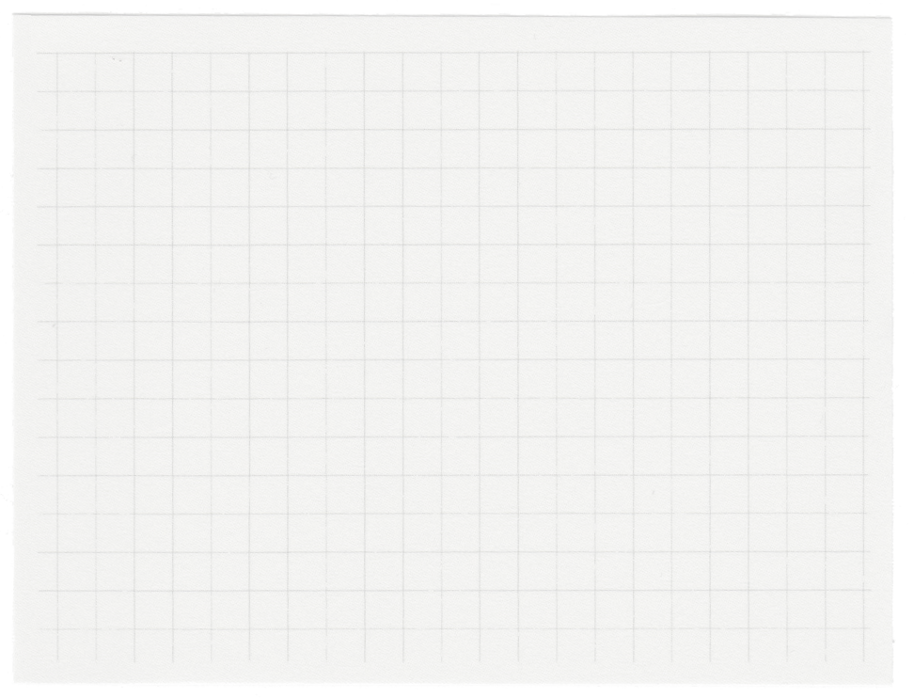















Team Pattern hunters
Project made as a part of DPBH-2024

Slide 2

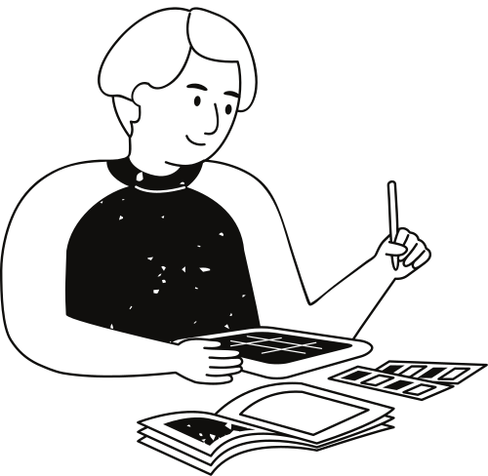
What is a dark pattern?
A dark pattern is a user interface designed and aimed at deceiving users into taking certain actions, such as purchasing excessively priced insurance alongside their buy or subscribing to recurring bills. These patterns are typically used in digital interfaces, such as websites or apps, and are intended to serve the interests of the designer or organization at the expense of the user's understanding or well-being.
WHY ARE DARK PATTERNS A CAUSE OF CONCERN?
Dark patterns are generally considered unethical and can lead to a poor user experience. They exploit psychological tendencies and expectations to guide users toward choices that may not be in their best interest.

Slide 3

01.
Data collection and preprocessing. Creating word embeddings and removing stop words, applying text augmentation. Filtering of datasets according to requirement.
Our Proposed Solution
Developing an NLP browser extension, we leverage labeled datasets to enable users to identify dark patterns while continuously refining its detection accuracy through user feedback. Our goal is to provide an evolving tool that enhances user awareness and combats deceptive online design practices.
Training the NLP models using BERT and codeBERT models. Using them we can cover a significant portion of dark patterns detected from text and page designs. Deploying the model in the form of a browser extension along with additional features.
02.
Using web scrapping, collecting the web page script from the user side and then testing it through the ML model. Alerting user about the presence about dark patterns and also improving accuracy using continuous feedback.
03.

Slide 4
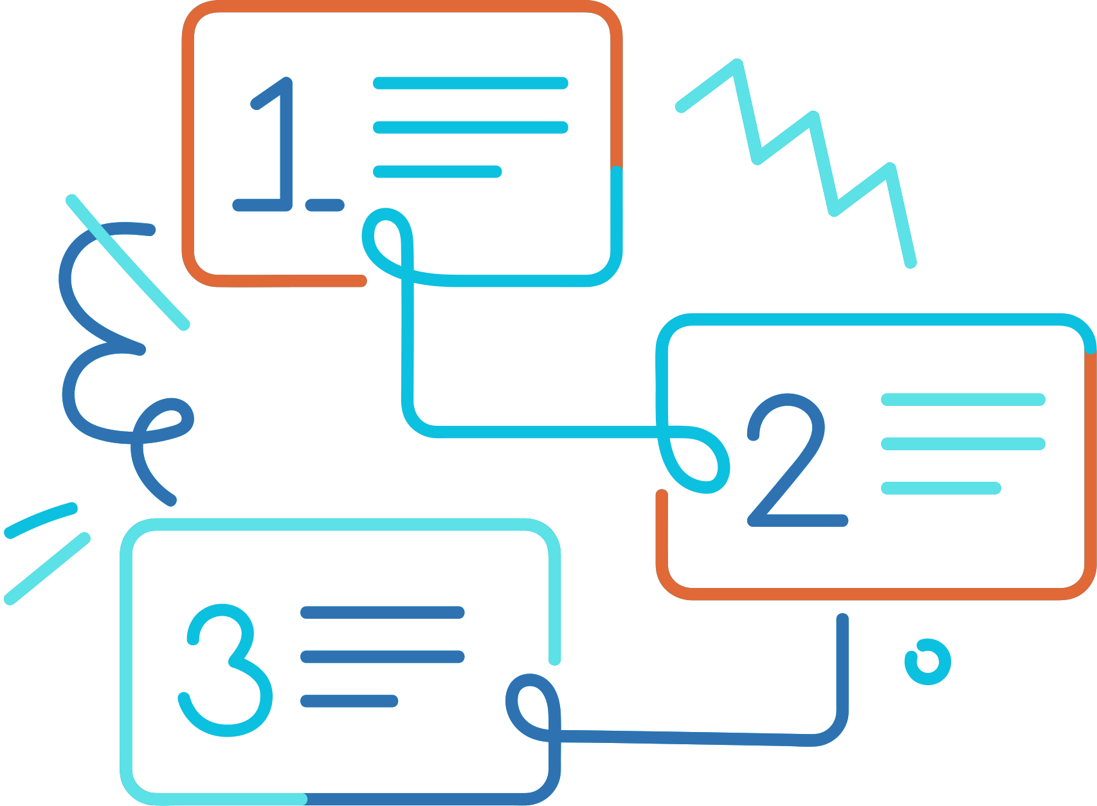
Solution Workflow
01
02
03
04
Web Scrapping and data storage.
Preprocessing on data done for removing reduncancies.
Data sent to the ML Model using the flask server.
Labelling assigned to dark patterns.
The output data from the ML Model sent to the extension using flask server and the prompt displayed to the user.
Feedback for ML Model collected and used to fine tune the model.

Slide 5
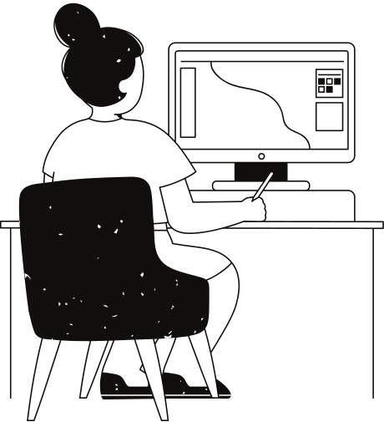
What is different in this?
Dynamic Iterative Learning:
Unlike static models, our extension evolves continuously through user feedback. By integrating a feedback mechanism, the extension learns from its mistakes, adapting to emerging deceptive tactics in real-time.
Holistic User Empowerment:
Beyond mere identification, our tool goes the extra mile to empower users. It doesn't just alert them to potential dark patterns; it provides actionable insights and user-friendly solutions. This includes not only highlighting active subscriptions but also simplifying cancellation processes with tailored suggestions.
Privacy-Centric Design:
Respecting user privacy is at the core of our design. Our extension analyzes patterns locally on the user's device, minimizing the need to transmit sensitive data to external servers. This approach not only enhances user trust but also ensures a secure browsing experience.

Slide 6

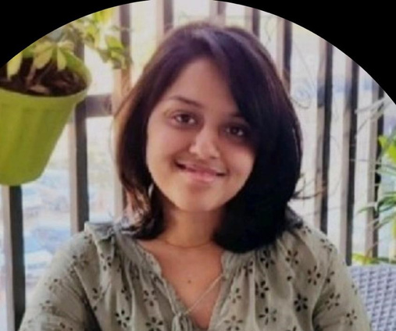


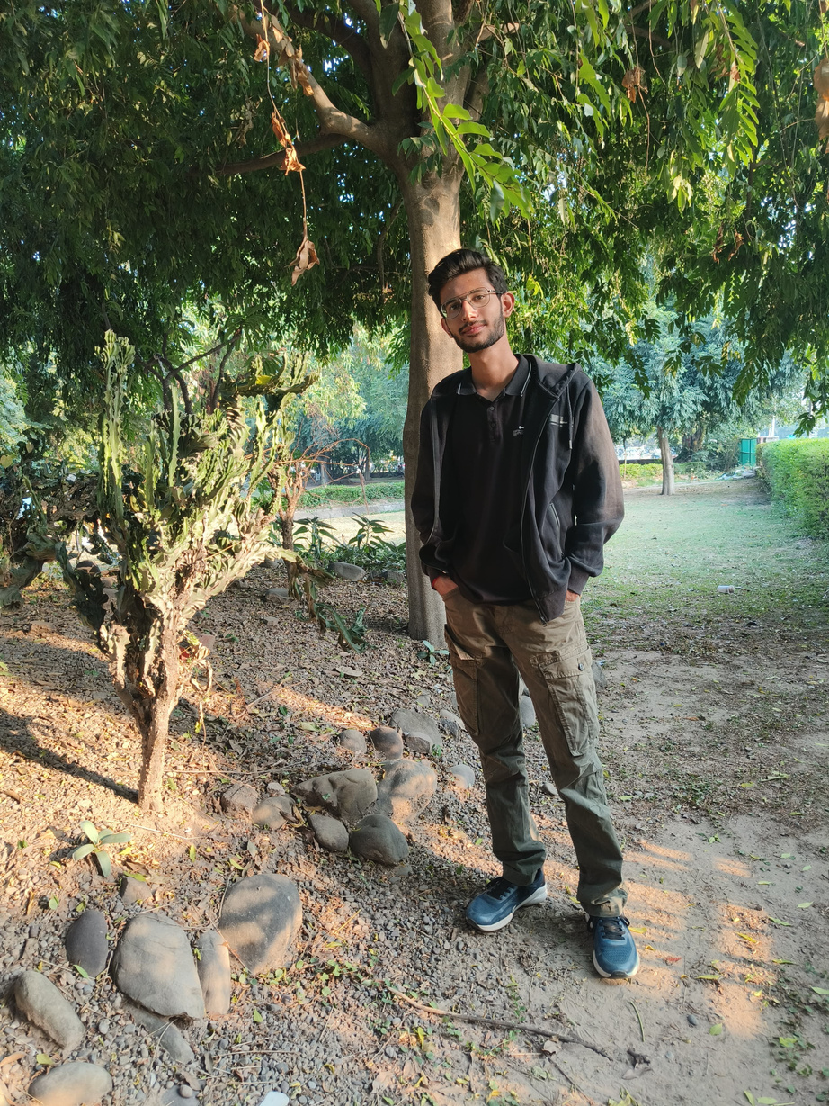

The Team
TEAM LEADER
Pranav Sharma
Akanksha Narula
Gaurav Gupta
Gurmehar Singh
Arnav Singh
Link to the GitHub repository

Slide 7
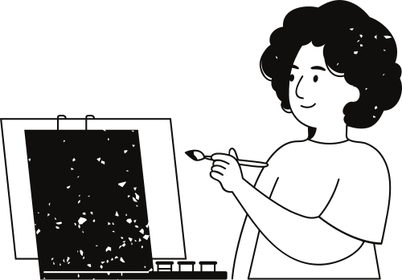

Future scope
Currently, we've built two detection models for dark patterns: one utilizing BERT and the other employing TF-IDF with Random Forest Classification. Future work involves refining their accuracy and exploring alternative combinations.
Addressing image/UI-based dark pattern classification poses an ongoing challenge. Additionally, we aim to enhance our feedback mechanism for continuous model improvement.

Slide 8
Thank you very much!

